Slide 1
Answering the June Exam paper
Prepared by G Khan

Slide 2
Question 1
Theoretical knowledge involves
learning without adopting a practical approach,
is gained by reading a book, an article, viewing a presentation, etc.
teaches about the experiences of others.
Practical knowledge is
obtained through hands-on experience of the concept under discussion,
by working on the concept and understanding through experience why some method is used, what problems arise while following the method, and how to rectify it, etc.
people generally learn something faster when they work on it.
Whether it be reading a lesson for an exam, learning a new language, or learning to ride a bike
the practical implementation of knowledge in real-life situations
enables you to learn through your own experiences

Slide 3
Question 1
Theoretical knowledge involves
learning without adopting a practical approach,
is gained by reading a book, an article, viewing a presentation, etc.
teaches about the experiences of others.
Practical knowledge is
obtained through hands-on experience of the concept under discussion,
by working on the concept and understanding through experience why some method is used, what problems arise while following the method, and how to rectify it, etc.
people generally learn something faster when they work on it.
Whether it be reading a lesson for an exam, learning a new language, or learning to ride a bike
the practical implementation of knowledge in real-life situations
enables you to learn through your own experiences

Slide 4
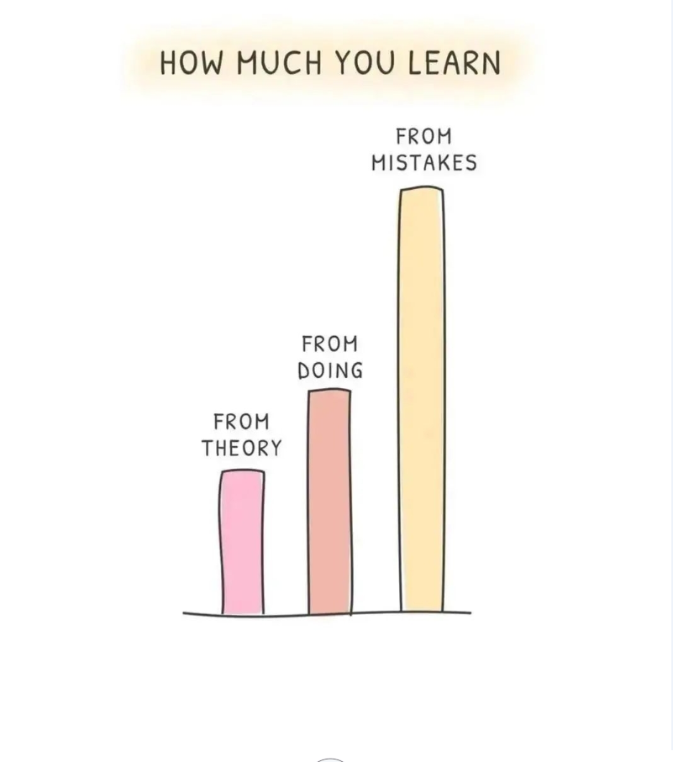
Types of Knowledge cont.
Practical knowledge combined with theory creates a clear explanation of the facts.

Slide 5
Theory Questions
Theory or essay questions
require you to write the answers to questions.
they assess your ability to recall relevant information, analyze it and explain it in an organized manner.
The assessment of high-order or critical thinking determines your ability to
interpret a situation and
correctly infer that a problem exists,
analyze why the problem continues to exist, and then
explain and evaluate attempts to solve the problem.

Slide 6
Why assess Critical Thinking skills?
Critical Thinking is valued both in the university setting and in the professional world of work.
In higher education it is an expected norm as develops judgment, evaluation, and problem-solving abilities.
It enhances academic performance and is part of lifelong learning - much like IT itself.
It helps creative thinking.
Practical tips for applying these skills in an exam are presented next.

Slide 7
1. Make sure you understand all the instructions
Read the instructions carefully so you can understand what the examiner expects from you properly. For example, do they want you to select 4 out of 5 questions? Or is there a question you must compulsorily answer?
Take note of how your examiner wants you to present your answer. Are you expected to explain, describe, list, or differentiate between two terms?
These are some terms you will come across in your essay questions and it is important that you understand these terms so you can present your answer exactly how they are required. For more detail on the terms go to the documents on Bloom’s taxonomy in the Content section on Blackboard and listen to the PowerPoint presentation and class recordings where this is covered.

Slide 8
2. Answer the easy questions first
Browse through the questions after reading the instructions and select the questions in the order ranging from easy to difficult.
Start answering the questions which are easiest for you before tackling the more challenging ones.
Remember,
you can’t waste time during an exam and
you can always come back to a question once you are done answering all the other questions.

Slide 9
3. Break down complex questions
Some questions may seem a bit difficult the first time you read them.
Apply your knowledge and skills as a software developer to these questions by breaking down the question into smaller sections.
As you work through each section take note of the essay terms used in the question These will help you work out exactly what is required in the question.
This analysis will help you understand the context of the problem and the topic(s) being assessed.
Combine your thoughts and responses into a cohesive answer.

Slide 10
4. Answer questions according to the marks given.
After reading and understanding a question, check the number of marks allocated to it.
This will give you an idea of how bulky or short your answer should be.
You can’t write an answer of 2 or 3 lines for a question that has 20 marks attached. It will definitely earn you about 2 or 3 marks for that question.
Neither should you write an answer of 20 lines for a question of 2 marks. Not only would you have wasted precious exam time but you would have written unnecessary points which will not earn you more than the 2 marks that are assigned to that question.
The marks allocated will also tell you how important a question is.
This will help you prioritize when answering all the questions.

Slide 11
5. Write legibly and arrange your answers neatly
Make sure you write in a manner that your work can be read once without any difficulty.
Try your best to arrange your answers neatly so that they can be easily traced to the questions when marking your scripts.
Remember to number your answers and label diagrams, charts, etc.
Avoid drawing in ink.
When required provide explanatory text to accompany visuals.
Read through your work carefully before submitting it.

